Slide 1
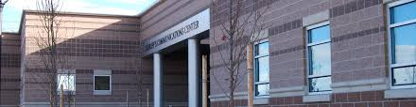
ARRIVAL REPORTS REVIVAL!
  UPDATING TEMPLATE FOR CONSISTENCY ACROSS AGENCIES

Slide 2
BACKGROUND
  Communications Request TOs Address Arrival Reports
  Build Consistency Across Arrival Reports
  Fire Agencies to Drive Effort and Outcome

Slide 3
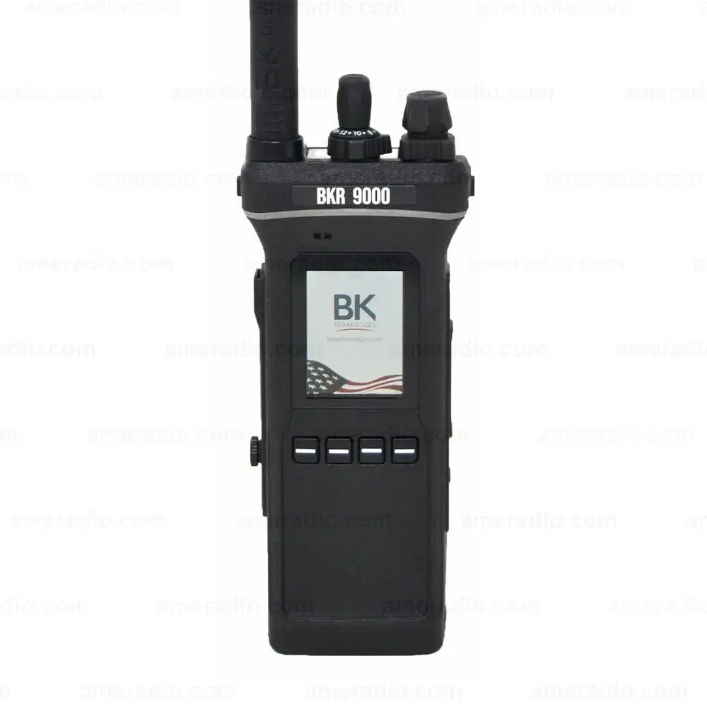
PROCESS
Training Officer Subcommittee
  Officer Experience
Existing Templates
  Structure – Larger Department Influenced
    Blue Card
  Wildland Resources Plentiful
  CLICR
Engagement
  Lefthand, Four Mile, Comms Center, Boulder Rural, Sunshine, FTC, and more…BES and RMR (soon!)

Slide 4
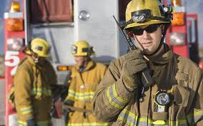
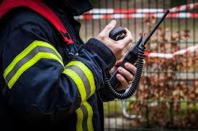
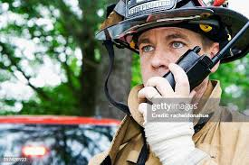
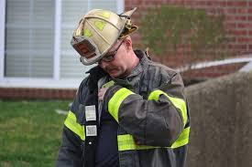
INPUTS
Communications Center…Doesn’t Need Much!
  Confirm Location
  Actionable Items
    Utilities
    Resources
  CPR in Progress
  Anything You Think is Immediately Relevant
  Name Command!
Subcommittee and Responders
  Details, Details, Details…Everything Else!
  Size-up Programs, Greater Sophistication are Drivers

Slide 5
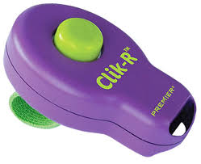
WHY NOT ?
Larger Department Use of Commercially Provided Programs
More Sophistication and Experience
Higher Level of Detail Expected on SO/BC FIRE
BUT…It is memorable, simple, and we will talk more about (something like) this

Slide 6
OUTCOME
Series of “Cards” for Arrival and an Update
  Structure
  Wildland
  MVA
  Medical
  Rescue*
CLICR Sandwich
  Horizontal Top and Bottom “Essentials”
  Vertical Menu “Pertinents” (formerly known as “Incident”)
Don’t Mistake a Lot of Words for Complexity
ARRIVAL REPORT - MVA
State UNIT NUMBER, Confirm LOCATION
Number of Vehicles and Type | Mechanism | Damage | Vehicle Position | Occupied | Injuries | Resources
SINGLE VEHICLE MULTIPLE VEHICLES (how many?) | ROLLOVER | MINOR | WHEELS | OCCUPENTS INSIDE VEHICLE | YES Severity? | EMERGENT or NONEMERGNET
TYPE Sedan Van Pickup Large Truck Semi Motorcycle | HEAD ON | MODERATE | ROOF | OCCUPENTS OUTSIDE VEHICLE | NO | RESCUE/EXTRICATION
 | SIDE IMPACT | HEAVY | SIDE (identify DRIVER or PASSENGER) | DRIVER AND OCCUPENTS NOT PRESENT AT SCENE | UNKNOWN | HELICOPTER
 | SIDE SWIPE |  | OFF-ROAD | BICYCLIST or PEDESTRIANS involved? |  | LAW
 | REAR END |  |  |  |  | CANCEL
State TRAFFIC IMPACT (Number lanes blocked or vehicles out of traffic)
Name COMMAND and Confirm TAC CHANNEL

Slide 7

We Need You!
FOR BETTER ARRIVAL REPORTS
Introduce Cards to Firefighters
  Practice (Classroom)
  Call Me!
BETA Test
  Reference On Scene
Provide SPECIFIC Feedback
  Memorable and Simple?
  Content – Too Little/Too Much
  Format
Input on Training Tools
  Scripts
  Images
  Clear Instructions
Join Subcommittee
  By December 1
  (Can Update Annually)

Slide 8


Slide 9
